Slide 1


Data Analytics

Slide 2


Project Recap
To provide a high-level overview of the business problem we're tackling and the precise requirements, we will provide a summary of the entire project.
Problem
We will get into the particular issue that the Data Analytics team has been concentrating on and provide some context for why this is such a significant issue.
The Analytics Team
Process
I'll start by outlining the issue and then discuss the team that is in charge of handling this assignment on our end.
After that, I'll go into the general steps we took to do this assignment so you can fully understand how we approach tasks of this nature.
Insights & Summary
Lastly, I will review all significant findings and offer them as a collection of understandings and illustrations from our

Slide 3

“Social Buzz,” a rapidly growing technology unicorn, aims to adapt to its global reach. Accenture is currently engaged in a three-month proof-of-concept (POC) with the following key activities:
1. Big Data Analysis: Investigating Social Buzz’s utilization of big data.
2. IPO Strategies: Developing strategies for a successful initial public offering (IPO).
3. Content Category Analysis: Identifying the top five content categories on Social Buzz.
Project Recap

Slide 4


Problem
Data Volume and Unstructured Content: Social Buzz receives a staggering volume of content—over 100,000 posts daily, totaling 36,500,000 posts annually. The challenge lies in managing this unstructured data effectively.
Project Objectives:
Data Integration: Combine tables from the sample dataset to create a unified data source.
Content Category Analysis: Identify the top five content categories with the highest overall popularity.
Key Deliverables:
A consolidated dataset that integrates relevant tables. Insights into content categories, including popularity metrics.

Slide 5
Understanding Data
Process
1
Data Cleaning
2
Data Modelling
3
4
Data Analysis
5
Uncover Insights

Slide 6

Insights
Unique Categories
Category with highest scores
ANIMAL
Most Post in Month
16
75K
MAY

Slide 7
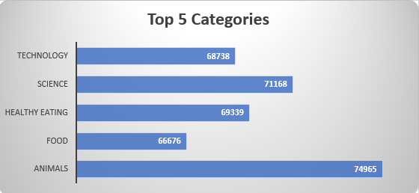

Slide 8
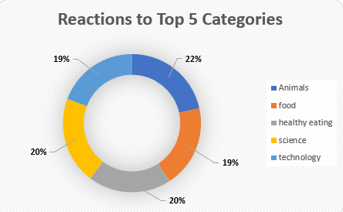

Slide 9
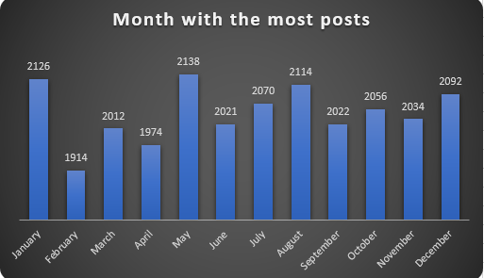

Slide 10

ANALYSIS
Based on the popularity of content categories, I recommend focusing on “Animals” and “Science.” These topics resonate with users who appreciate real-life and factual content. Keep creating more content in these areas to engage your audience effectively!
INSIGHT
Summary
Given the popularity of food-related content, especially “Healthy Eating,” consider leveraging this insight to collaborate with health-conscious brands. Creating a targeted campaign around healthy eating could significantly boost user engagement.
NEXT STEPS
Given the popularity of technology-related content, especially considering the rapid advancements in the field, collaborating with major digital companies could significantly boost user engage -ment. Capitalizing on this trend is a smart move!

Slide 11

Thank you!
ANY QUESTIONS?

